Slide 1
RPM Sales Training
Clovis ai

Slide 2
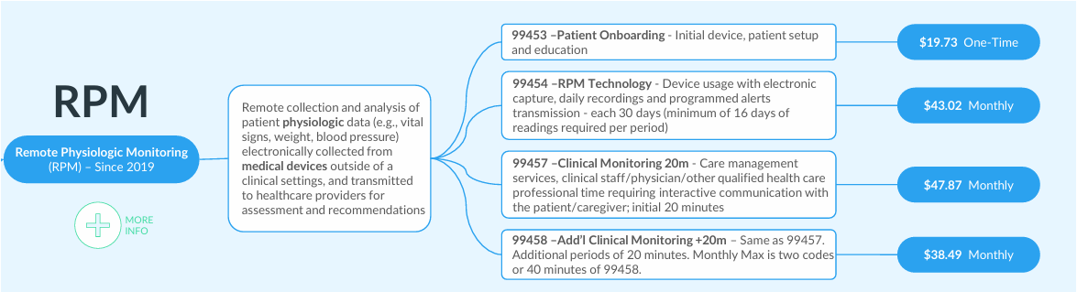
RPM Reimbursement Tree
Remote Physiological Monitoring or RPM
Remote monitoring of patient's physiological data (e.g. Vital Signs, weight blood pressure) electronically collected from medical devices outside of a clinical setting and transmitted to healthcare provider for assessment and recommendation.

Slide 3
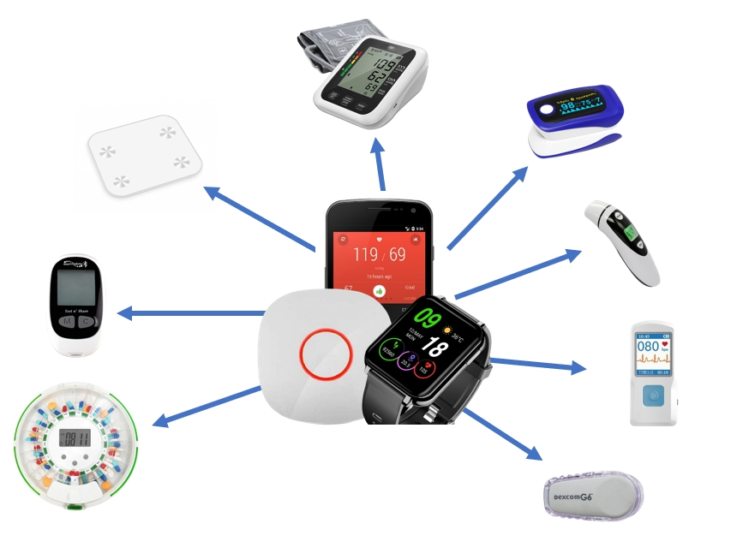
Clovis AI RPM Services
$60.00 Per Patient Per Month
UP TO 3 Devices
Requirements for CPT 99453
Requirements for CPT 99454
Requirements for CPT 99457
Devices and 16 days of testing data
Data transmission, HIPPA Compliant Server, Software, Platform, Remote Updates
Customer and Technology Support through our Support Angels
Ongoing program support for life of the program

Slide 4
RPM Implementation
Physician signs and provides all contractual documents
Patients provided are verified for eligibility.
Onboarding telephone call occurs obtaining verbal consent and shipping address. (Required)
Devices are drop shipped to patient home and they receive a Welcome call to help set up devices and make first upload. (CPT 99454 - Technical)
Clinical staff provides monitoring services based off of the care plan from the provider. Includes responding to Alerts and 20 min communication per month. (CPT 99457 – Clinical)
Software Platform Provides Report every 30 days, for patients who meet all reimbursement requirements.
Physician Bills Medicare and Insurances
Clovis AI Sends invoice of $60 per patient per month to be paid by Physicians Practice.
Step 1
Physician Signs
Patients provided
Step 2
Verification
Onboarding
Step 3
Devices Delivered
Monitoring begins

Slide 5
Month One Breakdown
$19.73
$43.03
$47.87
Total Reimbursement: $110.63
LESS
$60.00 PPPM
$25.00 Onboarding
Month One Profit: $25.63 pp
Class | Code | Funds
CPT | 99453 | $19.73
CPT | 99454 | $43.02
CPT | 99457 | $47.87

Slide 6
Recurring Months Breakdown
$43.02
$47.87
Total Reimbursement: $90.89
LESS
$60.00 PPPM
Monthly Profit: $30.89 pp
Potential Additional Code 99458 for additional 20min clinical: $20
Additional Profit: $18.49
Class | Code | Funds
CPT | 99454 | $43.02
CPT | 99457 | $47.87
CPT | 99458 | $38.49

Slide 7
Qualifying Conditions
Chronic Diseases
Matching Devices
Hypertension
Diabetes
Congestive Heart Failure
COPD
Chronic Kidney Disease
ETC.

Slide 8
Questions:
Speak about CCM.

